Slide 1
A RefResher in Laboratory Statistics: Using R in Validations and Verifications
Amrom Obstfeld
November 22, 2024

Slide 2
Introduction to R and RStudio

Slide 3
Lesson Goals
Get oriented to R and RStudio
Learn some fundamentals of coding
Lesson Objectives
Log in and tour RStudio Cloud
Execute code at the console
Define and use functions
Define and create objects in the environment
Notes:
In this first session our goal is to develop some familiarity with the R programming language as well as some basic proficiency with coding fundamentals as they are implemented in R.
We will log into the R environment and learn about the how to execute code in the console.
Upon this we will layer concepts of functions and objects. We will use some basic functions and make some objects.
Finally we will load data and interact with a dataframe.

Slide 4



R
Programming language for
data analysis
RStudio
Interactive development environment (IDE)
Quarto Markdown
Computational document format
Notes:
We're all excited to get started programming and we will do that in just a few minutes.
Before we do that I want to introduce you to 3 items.
The first is R. R is a programming language for data analysis. There are lots of great things about R: it is freely available, great for data analysis, and very capable for producing impressive visualizations. And what I think is its greatest asset is the great community of folks using it for data science, and if this is your first time using R let me be the first to welcome you to this community via this workshop.
→ Then, there’s RStudio. RStudio is the name of a a piece of software. You can think of RStudio as a sophisticated text editor for writing R code.
→ Finally there’s Quarto Markdown. Quarto is a computational document format that has executable code usually written in R. I say usually because it’s actually possible to write code in python, C++, and a other languages inside of a Quarto document. Quarto also includes capabilities for annotating your work which is incredibly handy.
These three R’s synergize for a robust ecosystem for performing data analysis.

Slide 5
R for Reproducible Data Analysis
Notes:
One of the most powerful aspects of working in the R environment is the ability to conduct reproducible data analyses (those analyses that can be shared, revised, repurposed and reproduced) by others.

Slide 6
Replication vs Reproduction
Replication: other people collect new data
Scientific gold standard
Difficult and time-consuming
Reproduction: other people analyze the same data
Does not by itself validate the analysis …
Has been proposed as a minimal standard
Notes:
Focus of learning the skills we’re teaching today isn’t strictly research
But we should define 2 terms frequently discussed in the research world: Replication and Reproduction.
Replication: other people collect new data and reach the same conclusions
This is the scientific gold standard but is also difficult and time-consuming.
Reproduction: other people analyze the same data and reach the same conclusions
Reproduction does *not* show by itself that the study is valid. There could still be problems with external validity of the conclusions, however, since it’s theoretically so much easier than going out there and doing an entirely new study, reproducibility has been proposed as a minimal standard to examine the scientific validity of the conclusions of a study.
And as the data analysis part of a study becomes more complex, reproducibility of the data analysis becomes more important.

Slide 7
Why YOU should analyze your data reproducibly
“Can we redo the method comparison with this month’s data?”
“Why do the data in table not seem to agree with what I see in the figure?”
“Why did I decide to omit these six samples from my analysis?”
Your closest collaborator is You from 6 months ago
Notes:
But reproducibility doesn’t only help others. Consider the following 3 statements and ask yourself if they sound familiar.
-Can we redo the analysis with this month’s data?
-Why do the data in the Table not seem to agree with the Figure?
-Why did I decide to omit these six samples from my analysis?
→Your closest collaborator is you from 6 months ago. You can do yourself a huge favor by using tools that promote reproducibility.

Slide 8
Getting Started with RStudio
Notes:
Without further ado, let’s dive in!!
Getting Started with RStudio.

Slide 9

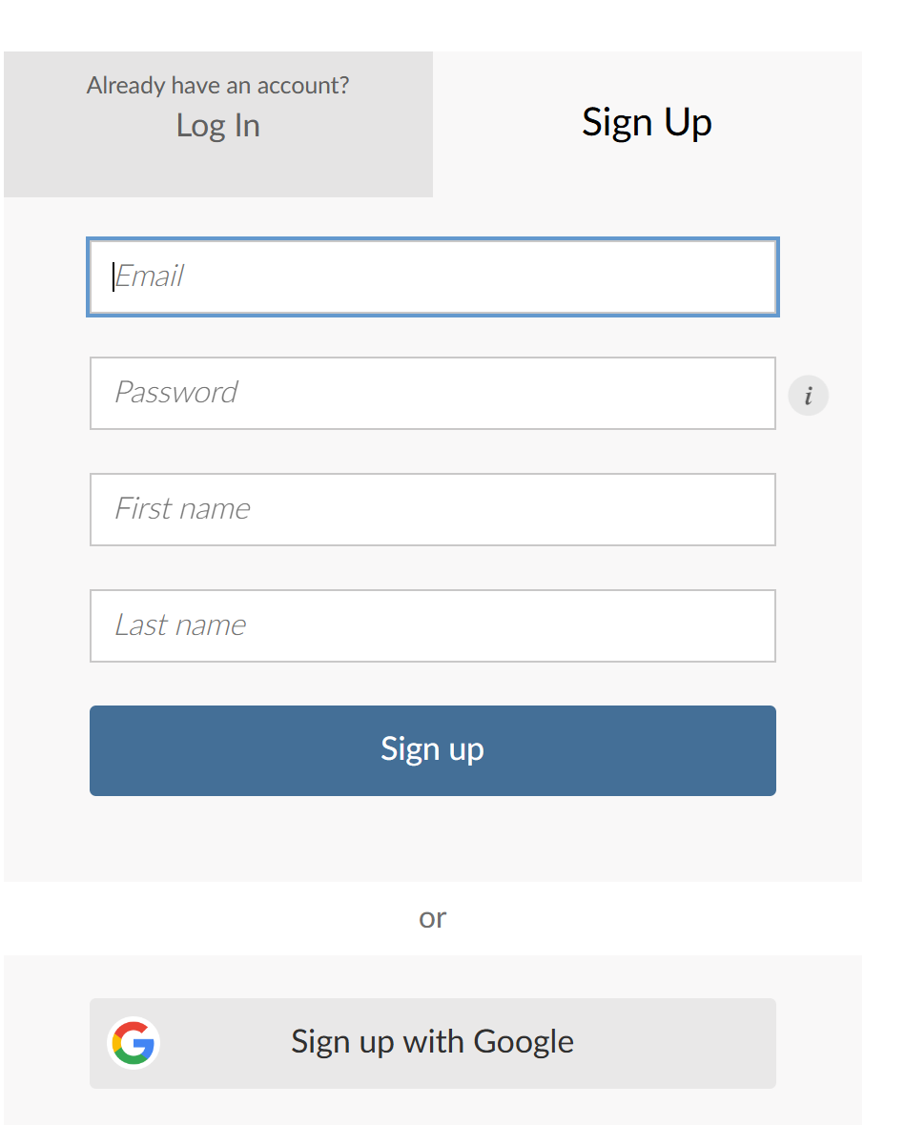
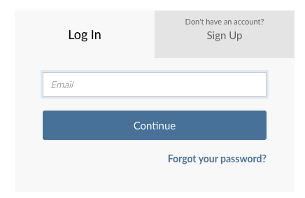
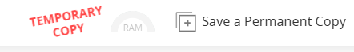
Your Turn #1
1
Go to https://bit.ly/r-amp24
2A
2B
3
OR
Notes:
Now let's get started setting up our R environment.
We're going to be using a cloud based Rstudio during today's workshop.
To get started please follow the steps on this slide.
Please go to this url.
Sign up for an account, or if you happen to already have a Rstudio account you can use those credentials to login.
Then on the top of the window you will see an option to Save a Copy of the Workshop project, please do that.

Slide 10
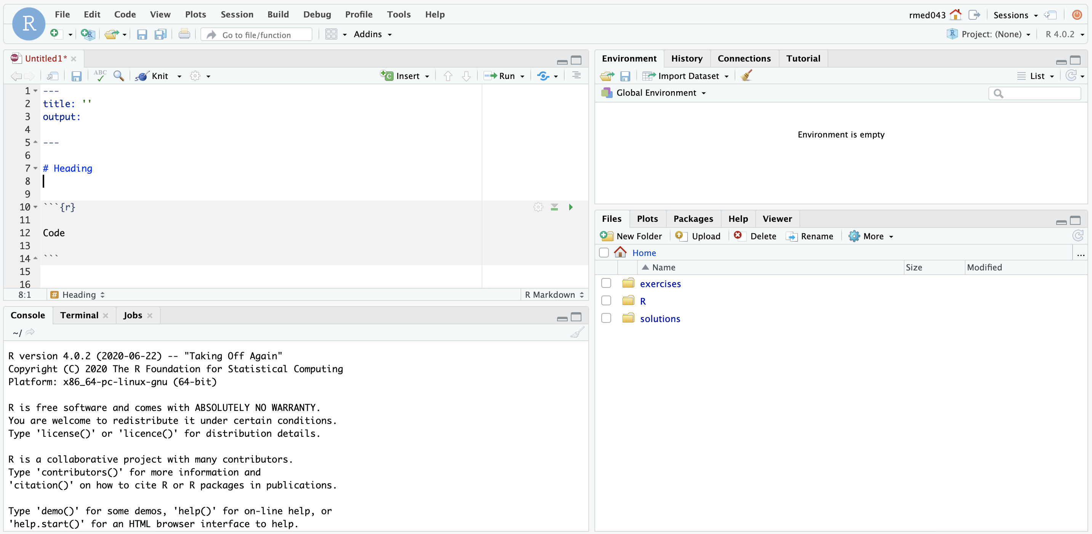
ENVIRONMENT
EDITOR
CONSOLE
MISC
Notes:
Here’s what the RStudio window looks like. Its separated into this quad window structure
On the top left is the editor. This is where you enter code. If you've just turned it on you won't see this open until you open a file.
On the top right is the Environment. The environment allows you to look at the data that’s loaded into R.
The Console is on the bottom left. You can use the console to quickly run an individual R command but what you do there is not saved in any way so we generally discourage making much use of this window.
The pane we have labeled “MISC” has a few of tabs. The most important one for today is the “Files” tab which shows the files we’ll be using for the course.

Slide 11

Notes:
Quarto Markdown, or just quarto, is a type of file that we most commonly use for writing R code. It provides us with features and tools to tackle the reproducibility problem.
The magic of quarto is that it allows us to craft a document composed of computer code mixed in with narrative annotation that in turn documents the purpose of the code. It allows us to note details and information about the decisions we made in our analysis.
R Markdown in other words provides us with a lab notebook interface for analysis, visualization, and annotation of our analytical work.

Slide 12
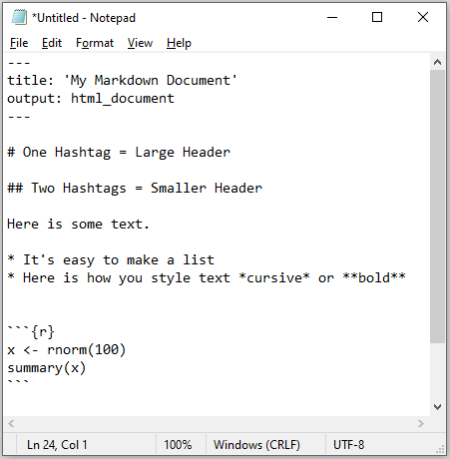
Anatomy of a Quarto Document
Notes:
Quarto documents are fundamentally just plain old ascii text files that you can open in any text editor like notepad.
However they are definitely not simple, with all their markings, which is why you're probably not going to want to edut them in notepad but rather in a program like Rstudio
→

Slide 13
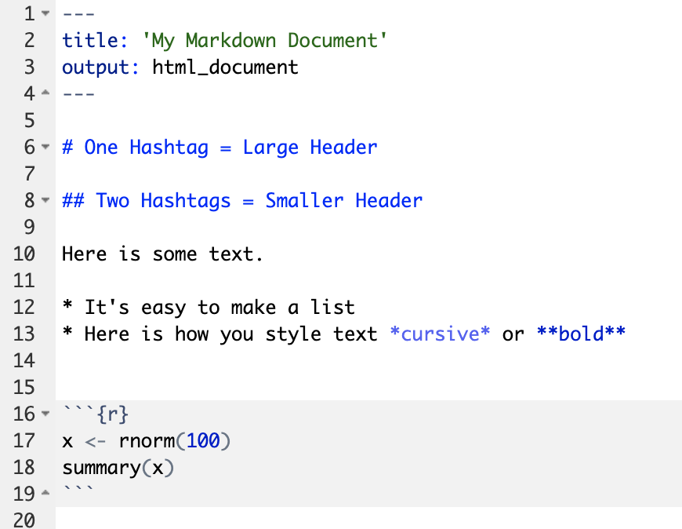
Anatomy of a Quarto Document
Header
Header
Text (with marks)
Code chunk
Notes:
Here is how the same document looks in Rstudio and you can already appreciate that Rstudio is trying to help us. the text is colored in different ways, we have numbered lines and there are other markings as well.
Quarto documents are composed of 3 basic building blocks.
**The first is the Header which includes pieces like the name of the document, the document’s author, and the desired output format when the document is assembled.
**The second block is the text. Quarto documents can be marked in ways that promote readability with various formatting styles.
**Finally, there are code chunks. Code chunks include include R code that can be executed to output results.

Slide 14
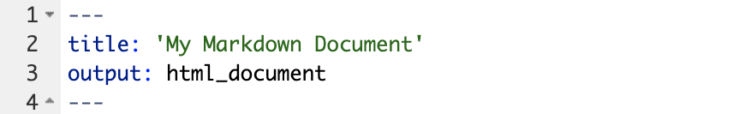
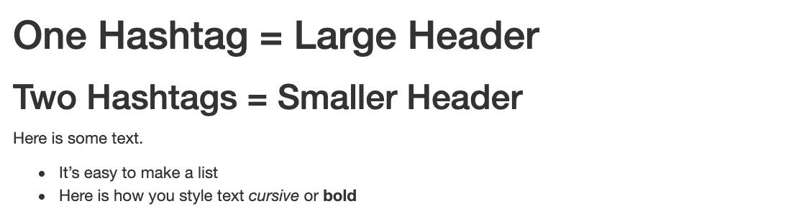
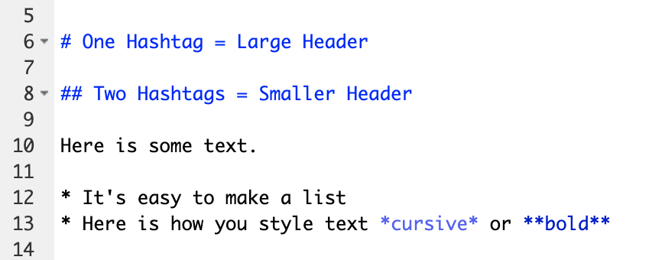
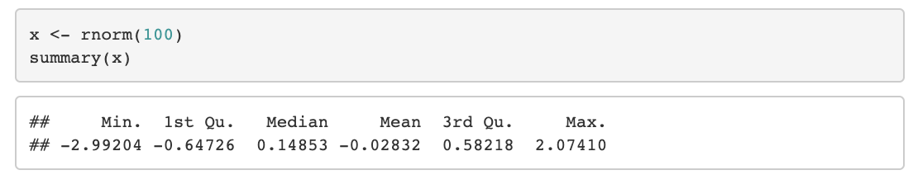
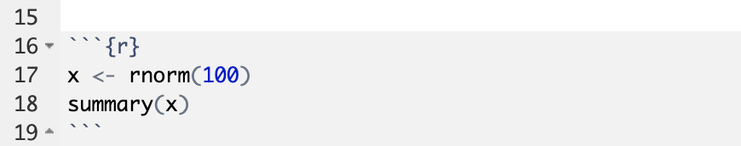
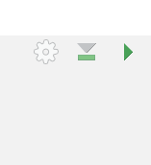
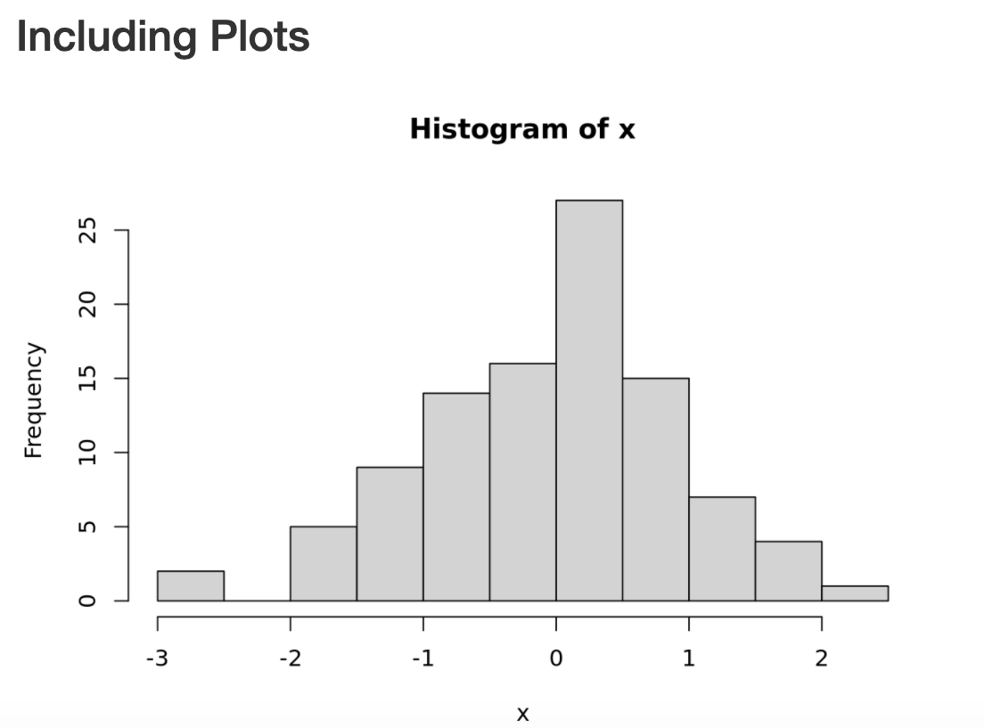
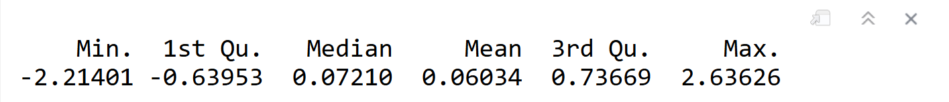
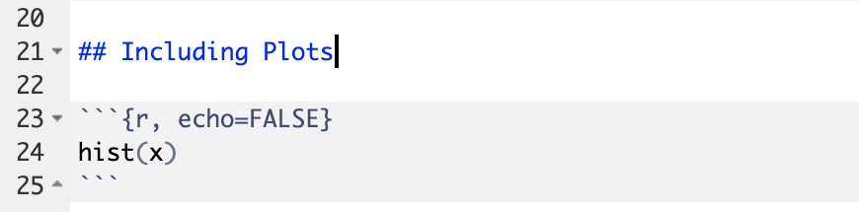
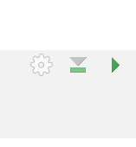
Notes:
So within the Quarto document we have a few different ways to run our R code
At the top right of every code chunk you'll see a green triangle. This is a play button and you use it to execute all the R code in a a single code chunk by ** clicking the “Run Code Chunk” arrow.
If you want you can also run each line in a chunk line by line by pressing ctrl-enter
Finally You can evaluate all the chunks and text in one go in a process called "rendering"
When you click the render button which is typically in the context menu above the quarto document, we can turn a quarto document from this
→to this.

Slide 15
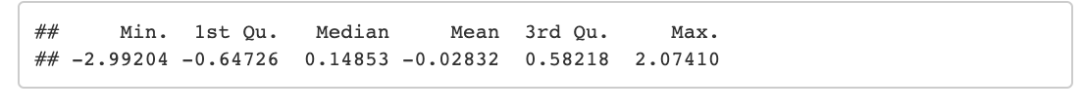
Notes:
Let’s look at this Quarto document in greater detail.
Again the first block is header section
** The second block includes narrative text with styling applied.
** Then we get to the code chunks (shown in gray boxes). Don’t worry about the grammar of these particular code chunks at this point. In brief the first code chunk generates 100 normally distributed values which are performing a summary on. The knitted document shows us our code ** and the output of that code.
** The second code chunk renders a histogram visualization of that data.
The result is a neatly formatted document that includes an annotated description of our analysis, the code we used, and the output of that code.

Slide 16
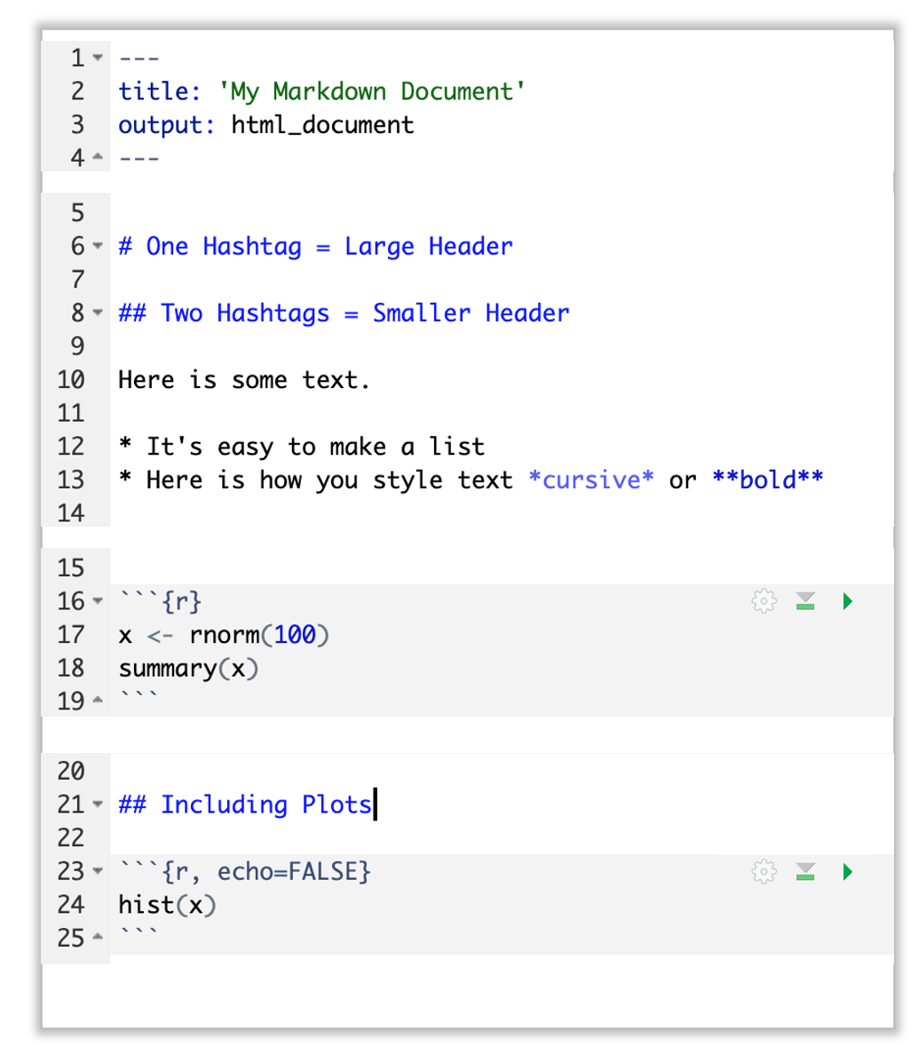
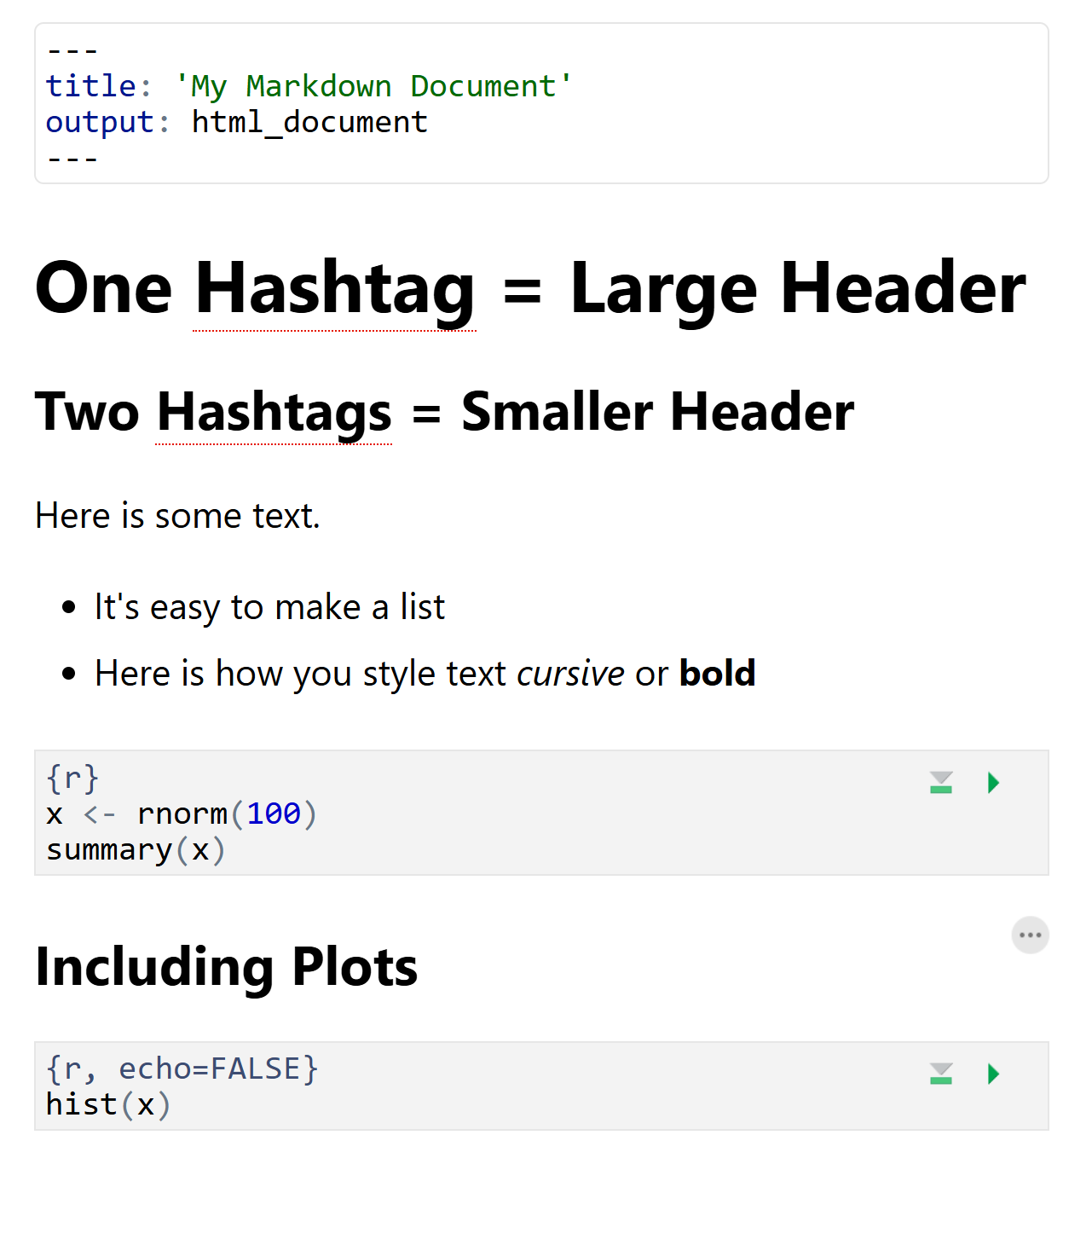
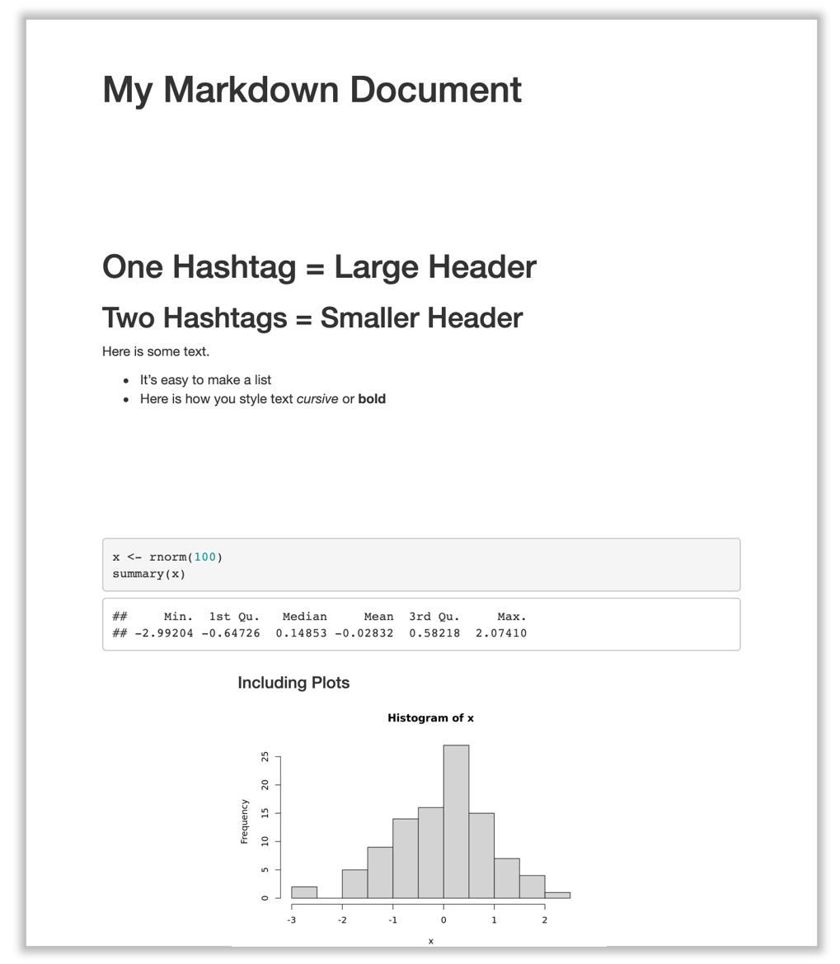
Quarto Visual Editor
Notes:
→Now in today's workshop we're going to be using a relatively new feature of Rstudio which is the Quarto Visual editor.
The Visual editor combines the ability to interactively edit your code, while simultaneously drafting your text with all the styles you would see in the final rendered output.
But if you prefer the old non-styled text editor that is still available, and that's actually how I prefer to code in R.

Slide 17
Your Turn #2
Open a sample Quarto document (File -> New File -> Quarto Document).
(A pop-up will ask you to choose some options, just click "create" button)
Review the format of the document: header, text, code chunks
Execute the individual code chunks by selecting the Run Current Chunk arrow.
Render the document to HTML (Render Button).
(You will be prompted to save your document first. Choose a name for your document and click save. )
Review the rendered document.
Notes:
OK It’s your turn again.
Follow the instructions in Your Turn #2 to
-open a Quarto document
-review the format
-execute individual code chunks
-render the document
We will meet back in 3 minutes to review this exercise together.

Slide 18
The Basics of Coding

Slide 19
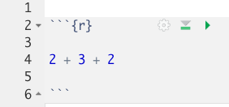
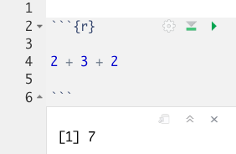
The Basics of Coding: Calculation
press play button to execute code
R is a calculator!
result returned here
Notes:
At it’s most basic, R is a fancy calculator.
It supports common mathematical operators
+ add, - subtract
* multiply, / divide
^ exponents
When we execute our code by pressing the play button,
→ the answer is returned below the code chunk.

Slide 20
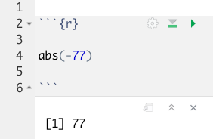
The Basics of Coding: Functions
Functions: Code that extends our reach beyond the basic operators
function
(does stuff)
argument
(input)
abs(-77)
Notes:
Now I'm sure no one is here to use R as a calculatior.
Functions are code that perform more complex actions on our behalf.
We can use functions that others have written (or that we write ourselves) to reuse code again and again.
Here we have the abs function which not surprisingly gives us the absolute value of a number
.→
Functions accept inputs within parentheses that we call arguments. We use parentheses as the syntax (grammar) to identify the argument(s).
When we run the play button, the function evaluates the arguments and provides us with some output, in this case the absolute value of an integer.
Now its important to recognize that the result of our code, in this case, is just output as something for us to view, but its not saved in any way

Slide 21
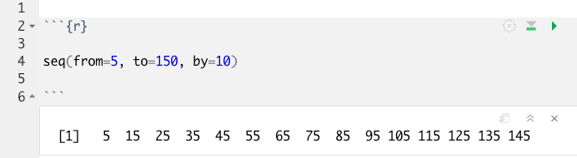
Putting Functions to Work
We can use functions to do more than simple math, we can make things!
We can create a series of integers (a vector) using the seq() function
Notes:
Functions can do more than simple math.
In this case the sequence function seq() accepts arguments defining a start position, a stop position, and an interval, to create a series (a vector) of integers.

Slide 22
The Basics of Coding: Objects
Objects: The container for your output
object
(stores output)
function
(does stuff)
arguments
(input)
sequence_of_10s <- seq(from=5, to=150, by=10)
Notes:
That is where objects come in
Objects are the containers in which we can store things for later use.
Objects are extremely versatile, You can store single values, series, tables, or even text.
In this example we are using the seq() function to create a series of integers and storing it out to an object which we have called sequence_of_10s.
The name of the objects is completely arbitrary its best practice to name things in intuitive easy to remember ways
The <- characters are called an assignment operator. They point to the place where we want to store output.
Now again, you can execute code without assigning it to an object however the output wont be stored. So if you want to revisit or reference the output of a particular line of code, you have to assign it to an object using the assignment operator <-

Slide 23
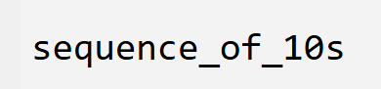
Checking the contents of an object
Notes:
So how do I access the values stored in an object?
Well if we just want to see the object's value you can simply place it in a chunk and run the chunk
→
The Quarto document will print out the value directrly below the chunk

Slide 24
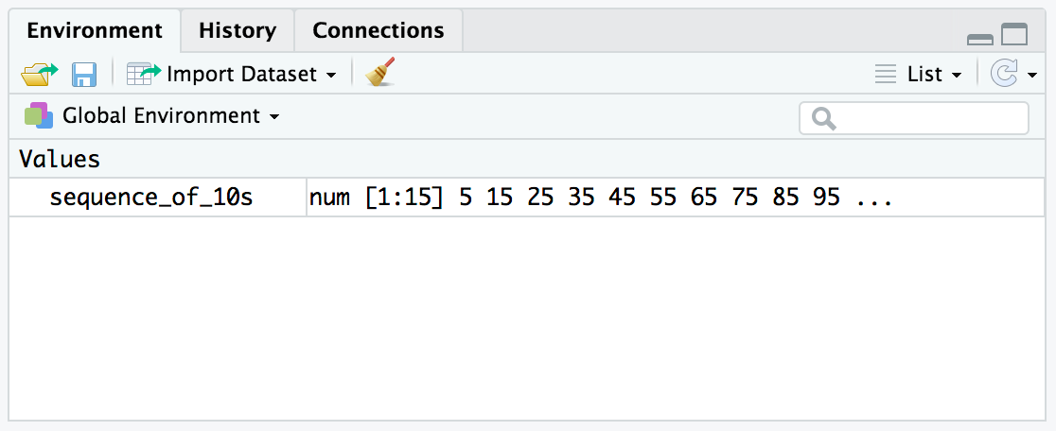
Checking the contents of an object
The environment tab shows us the objects we have created.
Notes:
Alternatively We can also review our object in RStudio via the environment tab, which again is in the upper right quadrant of RStudio

Slide 25
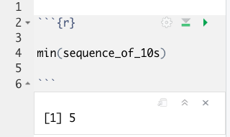
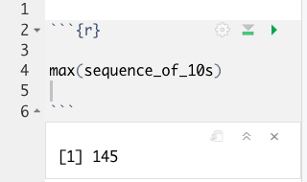
Bending objects to your will
Once we have created an object we can start to interact with it.
This includes passing our objects to other functions… Whoa!
Notes:
Objects are subject to same laws of programming we have learned so far.
We can provide the output of functions in the form of objects as arguments for future functions.
So for example
→ we can calculate the min of our sequence of numbers,
→ Or the maximum

Slide 26
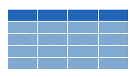


Dataframes: Beyond the Vector
Dataframe is the term for a table
Dataframes are composed:
Columns (Variables)
Rows (Observations)
Dataframes are objects and can be acted on like other objects
csv
xls
db
Notes:
One specific type of object deserves special mention
Dataframe is the term we use for a table, something with rows and columns along the lines of an Excel spreadsheet.
R accepts tabular data from a variety of sources including (comma separated value files, excel spreadsheets, or directly from databases). This is the import part of data analysis that is usually the start of a series of analytical operations.
Because we can store dataframes as objects we can perform actions on them just like other objects, including filtering, summarizing, joining and pivoting.

Slide 27
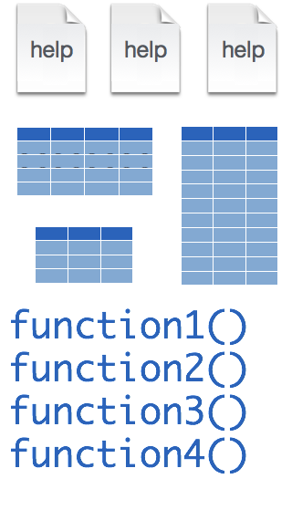
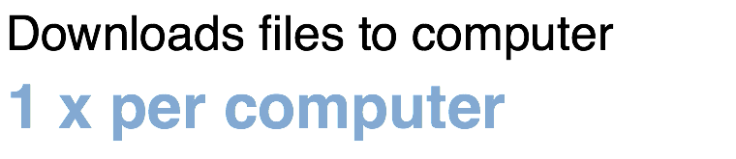
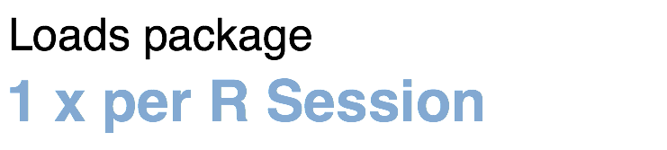
Installing and loading R packages
package
install.packages("packagename")
library("packagename")
Notes:
Now I'm imagine you've created functions that extend the functionality of R and help you with a data analysis challenge. You might want to bundle these all together and make that available to others. That’s where packages come in. a package is a series of functions, datasets and help files that all work together around a theme.
→ Packages need to be installed with the command install.packages. You go to an R chunk or the R Console and type install.packages(“packagename”).
Each package you want to use needs to be installed only once on each computer. However, in order to use the functions or data in the package, you also need to load the package.
→This is done with the command “library”. So every time you start a new R session you have to load each package that you want to use again.

Slide 28
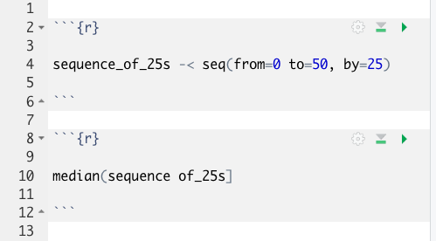
Your Turn #3
Open the file called "exercises/01 - Fixing Syntax.qmd"
I’ve written some code to create a sequence from 0 to 500 in increments of 25 called sequence_of_25s. Ultimately, I want to calculate the median value of this sequence. Unfortunately, I’ve made some mistakes in my code and I am hoping you can help me find them.
Notes:
OK, let's consolidate some of what we've learned.
Use the MISC pane in Rstudio to navigate to the exercises folder and open the 01 - Fixing Syntax.qmd file.
We will meet back together in a minute to see if we can fix this code together.

Slide 29
Tidyverse: R Packages for Data Science
A consistent way to organize data
Human readable, concise, consistent code
Build pipelines from atomic data analysis steps
Notes:
To import our CSV data, we need some additional data analysis tools. In this course, we will be leveraging the Tidyverse.
The Tidyverse is a modern set of tools for data analysis in R. It’s quickly becoming the de facto standard for doing data science with R.
The basic tenets of “tidy” data analysis include:
Data should be organized in a consistent, standardized way. Each row is an observation, and each column is a variable. This is a very common way to organize data in a spreadsheet and might sound familiar from how you may already organize data in tools like Excel.
Programming code that acts on the data should be consistent, concise, and mimic the narrative language as much as possible.
Each data analysis can be broken down into a series of atomic steps, such as “select this column” or ”arrange the data by the values in that column”. An arbitrarily complex data analysis can be broken down as a pipeline of atomic steps.

Slide 30

Recap
Programming Language
Document Format
IDE
Functions do stuff. They accept Arguments to define parameters. We can store the output of functions in Objects using the assignment operator ( <- ).
Packages extend the functionality of R. They need to be installed once per computer and loaded each session.
Dataframes are the object types that store tabular data.
Notes:
To recap what we have covered in this introductory lesson.
We started by defining and differentiating R (the programming language) from Rstudio (the development environment) from Quarto Markdown (the document format we use for reproducible data analysis).
In addition to learning to create and edit Quarto documents we discussed some basic coding vocabulary including:
-Functions do stuff on our behalf, they accept arguments, and we can store their output in named objects using the assignment operator
-Packages (such as the Tidyverse) which extend the functionality of R. We us the install.packages() function to install packages, and the library() function to load them into the environment.
-Finally we discussed Dataframes which are the object types that store tabular data.

Slide 31
Thank you!
Notes:
At the end of each lesson we have included a what else section to introduce you to ”what else” you may want to explore and learn about after completing this course.
This includes helpful hints, other functions in the Tidyverse, and exciting packages you may want to check out.

Slide 32
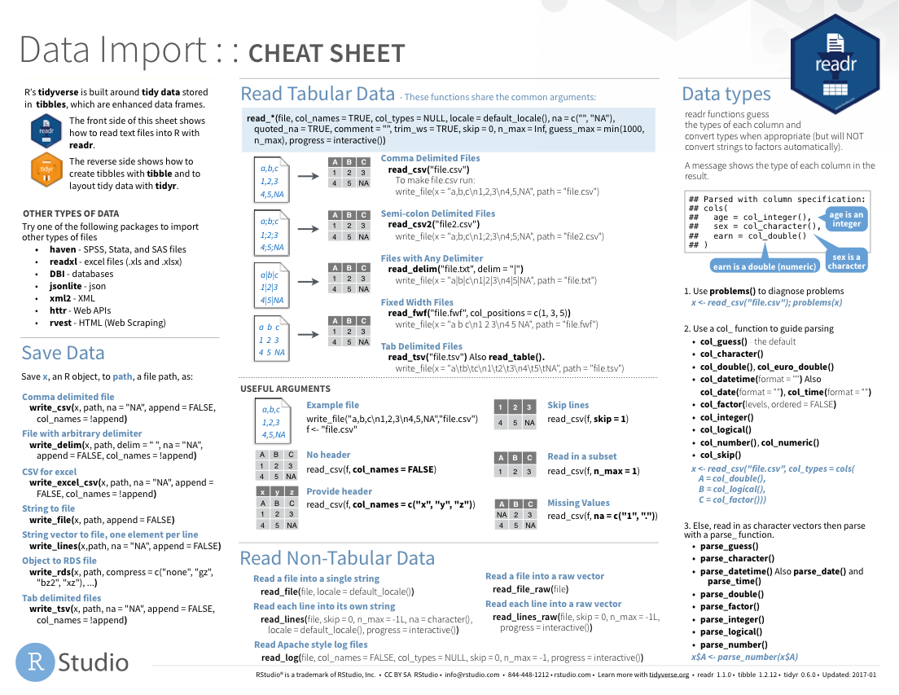
Notes:
The Data Import cheat sheet helps with the grammar of importing data including other file types and those with other separators (like pipes “|” instead of commas).
The Data Import cheat sheet is available on the RStudio website.

Slide 33
Notes:
There are a variety of other packages out there designed to deal with different file formats:
Readxl: Excel
Haven: SPSS, Stat, SAS files
Googlesheets
Rvest: scrape the web
Jsonlite: JSON data and APIs on the web

Slide 34
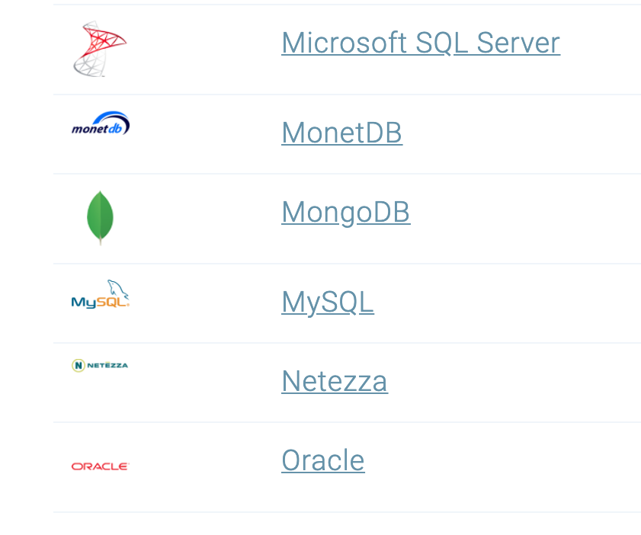
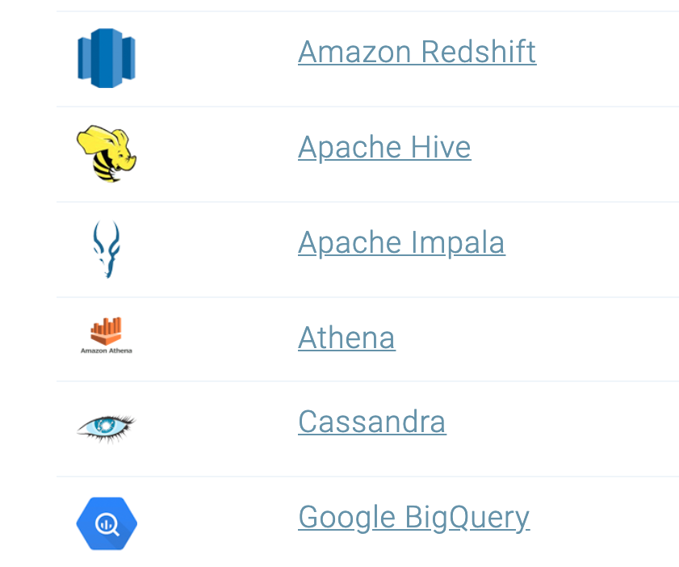
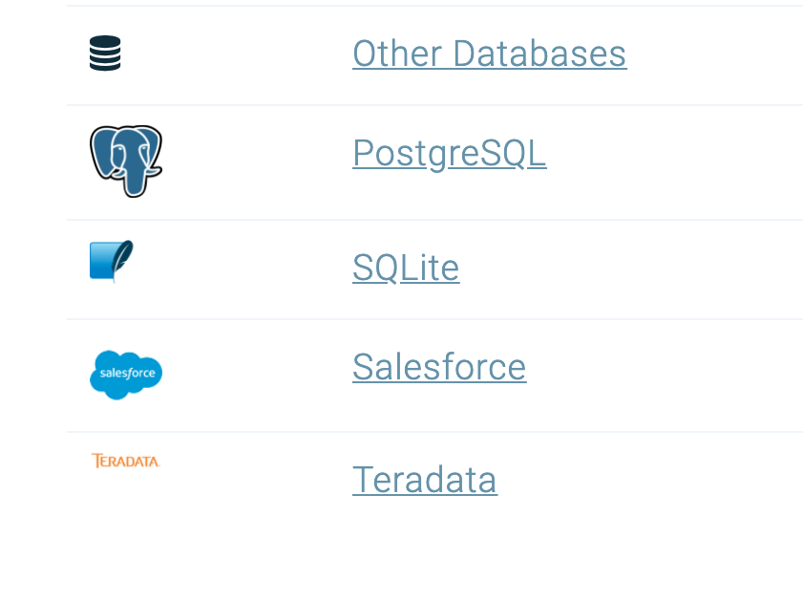
Databases
https://db.rstudio.com/databases/
Notes:
You can also connect to a variety of different databases directly in R to source your data.
If you use any of these, you may want to check out the tools to make database connections in R.

Slide 35

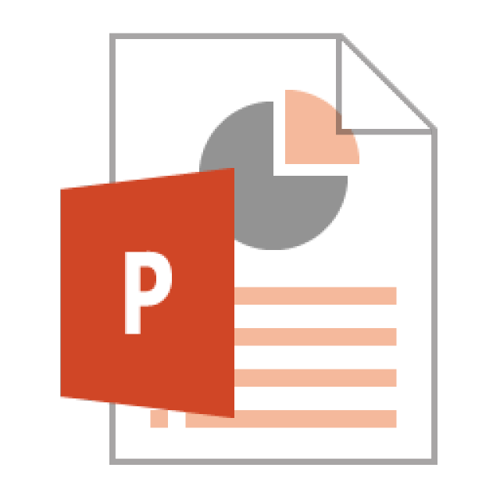



Notes:
In this lesson we practiced “knitting” our analysis to an HTML file.
In addition to HTML files, Quarto documents can be “knitted” into a number of additional formats including PDF, Microsoft Word, PowerPoint, and even interactive dashboards. We will look at dashboards in greater detail later in the course.

Slide 36
R Interface to Python
```{python}
import pandas
covid_testing.info()
```
Notes:
The reticulate package provides an interface between R and python.
This means, you can mix code chunks written in R with code chunks written in Python.
R does many things really well, but no programming language is perfect for all tasks. It is great that R gives us tools to mix and match languages in different code chunks in situ.
For those of you new to coding, we recommend focusing on a single language to develop proficiency before moving on to another language. This will shorten the learning curve for your first and future languages.

